Slide 1
CEN416: Assembly Language Programming
COURSE LECTURERS
TIWALADE ODU (Engr.)
OMORUYI OSEMWEGIE (Engr.)

Slide 2
Week 3 Topics
Intel 8086 microprocessor assembly language programming: Programming model as resources available to programmer, Addressing modes, instruction format, instruction set- arithmetic, logical, string, branching, program control, machine control, input/output

Slide 3
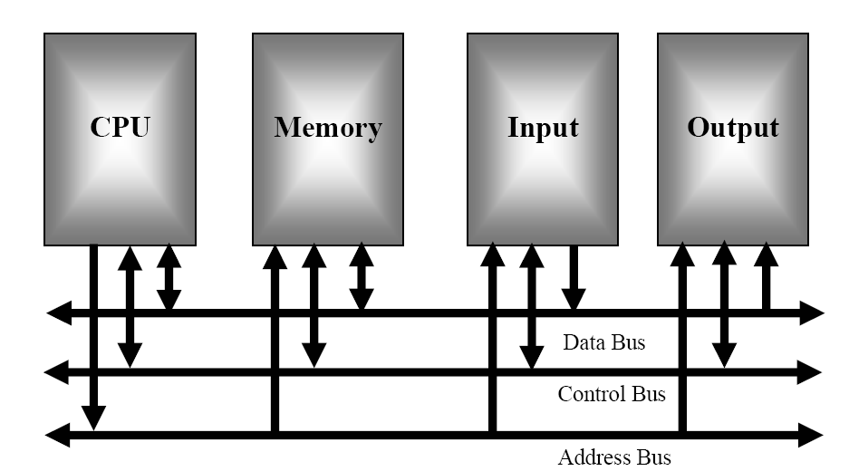
OVERVIEW OF MICROCOMPUTER STRUCTURE AND OPERATION (Von Neumann model of computer)

Slide 4
Von Neumann model of computer
The major parts of this model are the central processing unit (CPU), memory, and the Input and output circuitry or l/O.
The three buses are the address bus, the data bus, and the control bus.

Slide 5
Programming model
A programming model is a view of the microprocessor that explains how the microprocessor sees and uses various components and tasks of the microprocessor system. This includes memory and registers in the microprocessor.
The real mode programming model of a microprocessor is an operating mode of x86( 8086 microprocessor family) compatible microprocessors.

Slide 6
Types of Programming Models
Real-Address Mode- Real-address mode implements the programming environment of an early Intel processor with a few extra features, such as the ability to switch into other modes. This mode is useful if a program requires direct access to system memory and hardware devices.
System Management Mode System management mode (SMM) provides an operating system with a mechanism for implementing functions such as power management and system security. These functions are usually implemented by computer manufacturers who customize the processor for a particular system setup.

Slide 7
Types of Programming Models
Protected Mode- Protected mode is the native state of the processor, in which all instructions and features are available. Programs are given separate memory areas named segments, and the processor prevents programs from referencing memory outside their assigned segments.
Virtual-8086 Mode -While in protected mode, the processor can directly execute real-address mode software such as MS-DOS programs in a safe environment. In other words, if a program crashes or attempts to write data into the system memory area, it will not affect other programs running at the same time. A modern operating system can execute multiple separate virtual-8086 sessions at the same time.

Slide 8
Real mode programming model
The real mode model is characterized by the following:
The 20 bit memory address space (allowing as much as (2²⁰ =1MB of memory space) Memory access is done using Segmentation via a segment: offset system.
Unlimited direct software access to all addressable memory, I/O addresses and peripheral hardware.

Slide 9
Registers (8, 16, 32 and 64 bit) Fig. 3.1

Slide 10
Registers explained
The programming model contains 8-, 16-, and 32-bit registers. The 8-bit registers are AH, AL, BH, BL, CH, CL, DH, and DL and are referred to when an instruction is formed using these two-letter designations. For example, an ADD AL,AH instruction adds the 8-bit contents of AH to AL. (Only AL changes due to this instruction.) The 16-bit registers are AX, BX, CX, DX, SP, BP, DI, SI, IP, FLAGS, CS, DS, ES, SS, FS, and GS. Note that the first four 16 registers contain a pair of 8-bit registers.
An example is AX, which contains AH and AL. The 16-bit registers are referenced with the two-letter designations such as AX. For example, an ADD DX, CX instruction adds the 16-bit contents of CX to DX. (Only DX changes due to this instruction.) The extended 32-bit registers are EAX, EBX, ECX, EDX, ESP,EBP, EDI, ESI, EIP, and EFLAGS. These 32-bit extended registers, and 16-bit registers FS and GS, are available only in the 80386 and above.

Slide 11
Registers explained (64 bit)
The 64-bit registers are designated as RAX, RBX, and so forth. In addition to the renaming of the registers for 64-bit widths, there are also additional 64-bit registers that are called R8 through R15.
The 64-bit extensions have multiplied the available register space by more than 8 times in the Pentium 4 and the Core2 when compared to the original microprocessor architecture as indicated in the shaded area in Figure 3–1.

Slide 12
Registers Explained
An example of a 64-bit instruction is ADD RCX, RBX, instruction, which adds the 64-bit contents of RBX to RCX. (Only RCX changes due to this instruction.) One difference exists: these additional 64-bit registers (R8 through R15) are addressed as a byte, word, doubleword, or quadword, but only the rightmost 8 bits is a byte.
R8 through R15 have no provision for directly addressing bits 8 through 15 as a byte. In the 64-bit mode, a legacy high byte register (AH, BH, CH, or DH) cannot be addressed in the same instruction with an R8 through R15 byte. Because legacy software does not access R8 through R15, this causes no problems with existing 32-bit programs, which function without modification.

Slide 13
Real mode memory addressing
Only the 8086 and 8088 operate exclusively in the real mode. In the 64-bit operation mode of the Pentium 4 and Core2, there is no real mode operation. This section of the text details the operation of the microprocessor in the real mode.
Real mode operation allows the microprocessor to address only the first 1M byte of memory space—even if it is the Pentium 4 or Core2 microprocessor. Note that the first 1M byte of memory is called the real memory, conventional memory, or DOS memory system. The DOS operating system requires that the microprocessor operates in the real mode.

Slide 14
Segments and Offset
A combination of a segment address and an offset address accesses a memory location in the real mode. All real mode memory addresses must consist of a segment address plus an offset address.
The segment address, located within one of the segment registers, defines the beginning address of any 64K-byte memory segment. The offset address selects any location within the 64K byte memory segment. Segments in the real mode always have a length of 64K bytes.

Slide 15
Segments and offset (fig. 3.2)

Slide 16
Segments and Offset
Figure 3–2 shows how the segment plus offset addressing scheme selects a memory location. This illustration shows a memory segment that begins at location 10000H and ends at location IFFFFH—64K bytes in length.
It also shows how an offset address, sometimes called a displacement, of F000H selects location 1F000H in the memory system. Note that the offset or displacement is the distance above the start of the segment, as shown in Figure 3–2.

Slide 17
Segment and offset registers
The microprocessor has a set of rules that apply to segments whenever memory is addressed. These rules, which apply in the real and protected mode, define the segment register and offset register combination. For example, the code segment register is always used with the instruction pointer to address the next instruction in a program. This combination is CS:IP or CS:EIP, depending upon the microprocessor’s mode of operation.
The code segment register defines the start of the code segment and the instruction pointer locates the next instruction within the code segment. This combination (CS:IP or CS:EIP) locates the next instruction executed by the microprocessor. For example, if CS = 1400H and IP/EIP = 1200H , the microprocessor fetches its next instruction from memory location 14000H + 1200H or 15200H.

Slide 18
Segment and offset registers (Stacks)
Another of the default combinations is the stack. Stack data are referenced through the stack segment at the memory location addressed by either the stack pointer (SP/ESP) or the pointer (BP/EBP). These combinations are referred to as SS:SP (SS:ESP), or SS:BP (SS:EBP).
For example, if SS = 2000H and BP = 3000H, the microprocessor addresses memory location 23000H for the stack segment memory location. Note that in real mode, only the rightmost 16 bits of the extended register address a location within the memory segment. In the 80386–Pentium 4,never place a number larger than FFFFH into an offset register if the microprocessor is operated in the real mode. This causes the system to halt and indicate an addressing error.

Slide 19
Segment and offset register 16 & 32 bit (fig. 3.3)

Slide 20
Addressing Mode
An addressing mode specifies how an operand required by an instruction is transferred to (or from) the CPU.
Common forms of addressing modes:
Register
Immediate or Literal
Direct
Register Indirect
Base or Displacement
Indexed

Slide 21
Taxonomy of addressing modes (fig 3.4)

Slide 22
Types of Addressing Mode
Register Addressing: the source/destination operand is a CPU register.
Immediate (Literal) Addressing: The operand is a part of the instruction fetched from memory.
Direct Addressing: The address of the operand is part of the instruction fetched from memory. In this mode the address is written in square brackets [address H] while H means that the address is written in Hexadecimal numbering system.
Register Indirect Addressing: The address of the operand is contained in a CPU register.
Base (Displacement) Addressing: The address is computed within the CPU by adding a value contained in a register to a base or displacement value. The base or displacement value is part of the instruction fetched from memory.
Indexed Addressing: The address is computed within the CPU by adding values contained in two CPU registers.

Slide 23
Addressing Instructions and Data
An instruction consists of
– at least one operation -- ADD, MOVE, AND
– zero, one or more operands to reference the data
– Generally in Intel Microprocessors, the first operand is the destination
Example:
MOV AX,25 ; immediate operand
MOV AX,[0025H] ; direct addressing
MOV BX,AX ; register to register
MOV BX,[AX] ; indirect addressing

Slide 24
Addressing Instructions and Data
– CS register contains the address of the beginning of a program’s code segment which contains instructions
– DS register contains the address of the beginning of a program’s data segment which contains data that instructions reference
– IP register indicates the offset address of the current instruction in the code segment to be executed
– Instruction operand indicates an offset address in the data segment to be referenced

Slide 25
Internal Instruction List
In a von Neumann computer, execution of all programs (even those written in high-level languages) consists in execution of internal instruction sequences, which are contained in binary forms of these programs.
Internal instructions represent almost all operations that a computer can perform. This does not concern operations, which are not programmable by the user of the computer. Such operations are said to be 'hardwired or wired in', as for example interrupt handling or cache functioning.

Slide 26
Internal Instruction List
The set of all internal instructions provided in a given computer (understood as a set of operations defined by these instructions) is called computer instruction list or computer instruction set.
Based on the type of operation performed in an instruction, we distinguish the following types of internal computer instructions:
arithmetical-logical instructions,
data transfer instructions,
bit manipulation instructions,
program control instructions,
system instructions.

Slide 27
Arithmetical instructions
Arithmetical-logical instructions include three groups of instructions: arithmetical, logical and shift instructions. Some examples coming mostly from Pentium processor instruction list are given below.
Arithmetical instructions
ADD Arithmetical sum of arguments - addition.
SUB Arithmetical difference of arguments - subtraction.
MUL Arithmetical product of arguments with single or double precision - multiplication.
DIV Division.
ABS Computation of the absolute value of the argument.
NEG Reversing the sign of the argument - negate sign.
INC Increment the argument by 1.
DEC Decrement the argument by 1.

Slide 28
Logical instructions
AND Logical AND on arguments.
OR Logical OR on arguments.
EXOR Exclusive OR on arguments.
NOT Complement of the argument - negation.
Shift instructions
SHL/SHR Logical shift of the argument - shift left / shift right.
SAL/SAR Arithmetical shift of the argument - shift arithmetical left / shift arithmetical right.
ROL/ROR Rotate left / rotate right the argument.

Slide 29
Data transfer instructions
MOV Transfer between registers or a register and memory - move.
STR Transfer between memory and a register - store.
MOVSX Transfer of byte, word, double word with the sign extension from register or memory to a register - move single/double.
LEA Load effective address from memory to a register.
PUSH Transfer data from a register to the top of the stack - push.
PUSHA Transfer data from all registers to the stack - push all.
IN, OUT Data transfer in/out from input/output devices.

Slide 30
Bit manipulation instructions
BTS Bit test and set operation, current value of a bit is copied to the CF flag and the bit is set to 1 - bit test.
BSP Bit testing for value 1; a word or a double word is searched for the first bit equal 1 and the position number of the first bit 1 is written into a register - bit set prime.
CLR Clear a register contents.
SET Set all bits in a register to 1.

Slide 31
Program control instructions
JMP Unconditional jump.
JE/JZ Conditional jump - jump if equal/ jump if zero.
CALL Subroutine call.
RET Return from a subroutine.
LOOPE/ LOOPZ Conditional jump which executes a loop iteration if a register is equal to a target value or zero - loop if equal, loop if zero.
INT / INTO Programmed interrupt or interrupt due to an overflow - interrupt / interrupt if overflow).
SKIP Skip execution of the next instruction.
HALT Stop execution of the program.

Slide 32
System instructions
LMSW Load a processor state word from memory or a register to the processor state register, switch to the supervisor mode - load machine status word register.
SGDT Store the global descriptor table register contents in memory.
LGDT Load global descriptor table register from a register or memory.
LSL Load segment limit to the segment register from a register or memory.
LDS Load a value to the segment pointer register from memory - load segment.
ENTER Create a frame in the stack for parameters of a procedure in a high level language - enter frame.
ESC Jump to execution of the program by the numerical co-processor - escape.
WAIT Wait for a change of the BUSY input.

Slide 33
References
The Intel Microprocessor, Architecture, Programming and Interfacing, 6th Ed., by Barr B Brey.
http://deeprajbhujel.blogspot.com/2015/12
/functional-block-diagram-of-8086.html
3.

